Slide 1
Computer Networks
Link Layer
S.V.Jansi Rani
Associate Professor / CSE

Slide 2
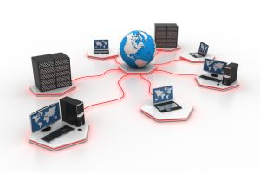


Slide 3
Link Layer
Introduction
Link-Layer addressing
DLC services
Data-Link layer Protocols -- HDLC --PPP
Media access control
Wired LANs: Ethernet
Wireless LANs : IEEE 802.11
Bluetooth
Connecting devices.

Slide 4
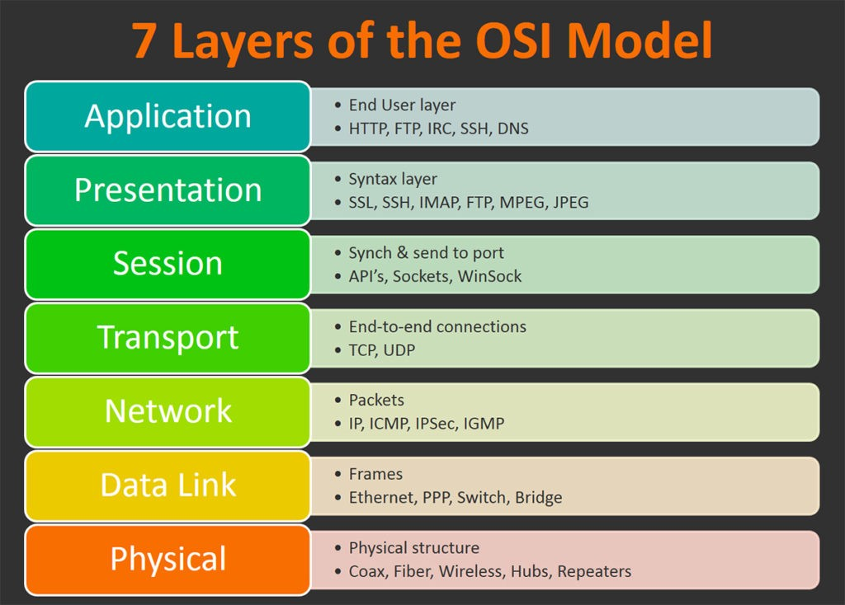

Slide 5
Link-Layer addressing
Unicast
Multicast
Broadcast

Slide 6
INTRODUCTION
The Internet is a combination of networks glued together by connecting devices (routers or switches). If a packet is to travel from a host to another host, it needs to pass through these networks.

Slide 7
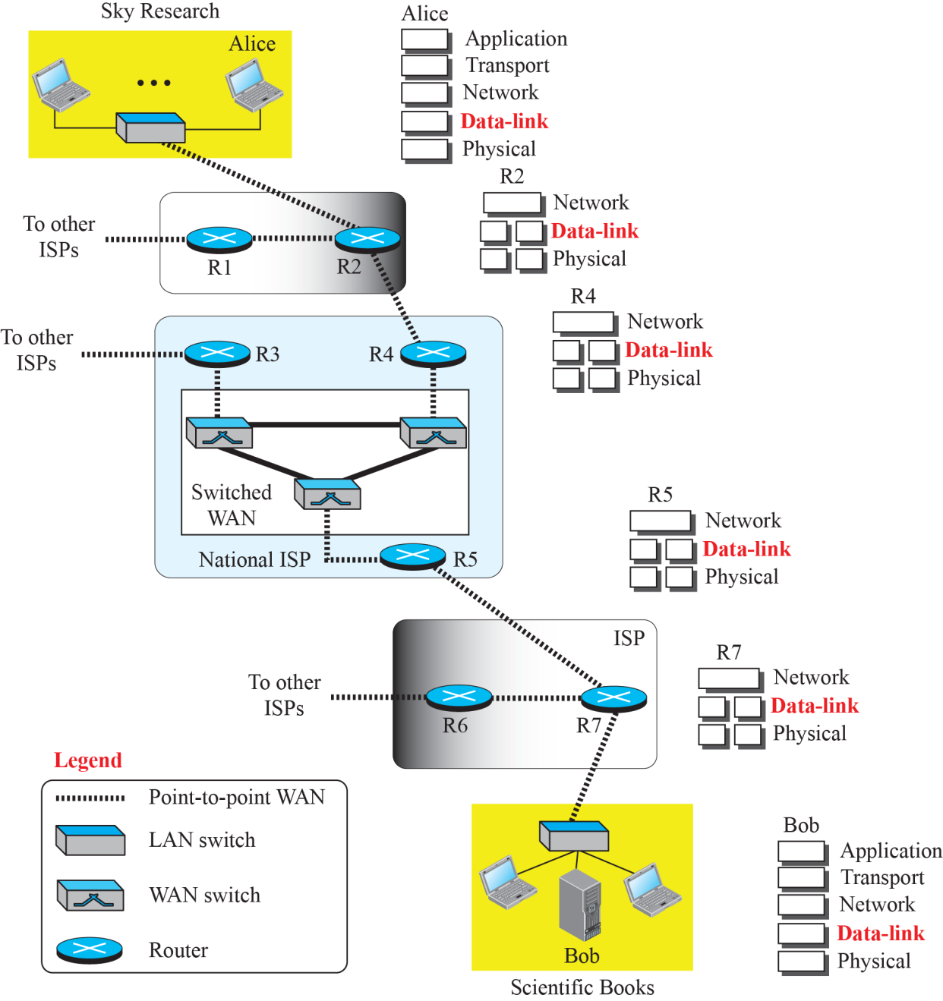
Communication at the data-link layer

Slide 8
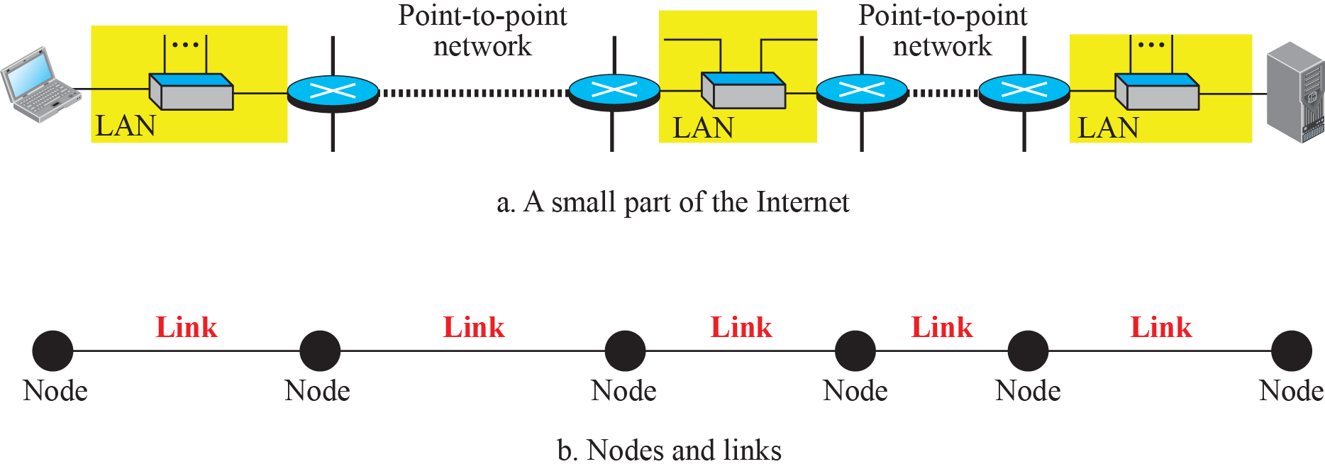
Nodes and Links

Slide 9
Services
Framing
Flow Control
Simple Protocol
Stop and wait Protocol
Go back N ARQ
Selective Repeat ARQ
DL Protocol
HDLC
PPP
Error Control

Slide 10
Media Access Control
Random Access
ALOHA
CSMA
CSMA/CD
CSMA/CA
Controlled Access
Reservation
Polling
Token Passing

Slide 11
Protocols
Wired Ethernet - IEEE802.3
Standard Ethernet, Fast Ethernet, Gigabit Ethernet
Wireless LAN - IEEE 802.11
BSS, ESS, Hidden terminal problem, Exposed Terminal Problem
Bluetooth
Architecture, piconet, Techniques

Slide 12
THANK YOU

